Slide 1
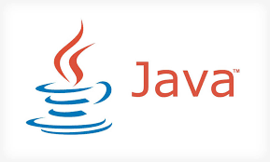

Slide 2
History
Java was developed by James Gostling , Patrik Naughton , Chrish Worth ,Ed Frank and Mike Sheridan at Sun Microsystem.
The first working version of JAVA was developed in 1991 and called “OAK” and renamed in 1995 as “JAVA” .

Slide 3
KEY FEATURES
Object Oriented Programming language
Platform Independent
Secured

Slide 4
Other Features
Simple
Portable
Multithreaded
Interpreted
Dynamic
High Performance

Slide 5
Object Oriented Programming language
In OOPS each and every thing is defined in term of Object.
Object : An instance of an entity having some state and Behavior.
Entity : Any thing in this real world having some attributes.
Example :
1) Car
2) Student
3) Bank Account etc…

Slide 6
Example.
Bank Account ;
Attributes for Bank Account are could be Account holder Name ,Balance and Type(saving/current).
Behavior of Account could be Withdrawal, Deposit And Account Balance.

Slide 7
The CLASS
The “class” is use to represent the Entity in form of Code.
A class can have two members….
1) Data Member
2) Function Member
Relation Map between Entity And “CLASS”
ENTITY CLASS
STATE
DATA MEMBER
BEHAVIOUR
FUNCTION MEMBER

Slide 8
Eample( CLASS )…… KEYWORD
class Account
{
int Account_Bal ;
String Name ; DATA MEMBER
char Account_Type;
void account_Bal()
{
// code to get the account balance.
}
void deposit()
{
// code for deposit the amount . FUNCTION MEMBER
}
void withdraw()
{
// code for deposit the amount .
}
}

Slide 9
Create an OBJECT
To Create an OBJECT….
Syntax :
ClassName DesiredObjectName = new ClassName ();
Example :
Account SBI= new Account();
What is going to be happen when we create an Object..
Lets have a look how to declare a variable in c-language
Syntax : datatype variable_name ;
Example : int age;
When control read this line it creates a memory named “age” and the structure will be depend on datatype i.e “int”.(size will be 2 byte and the memory can hold one integer value.).
2 byte
age
age

Slide 10
In c-language when we want to have a memory that can store more than one type ,we can use “structure”.
Lets have a look….
Syntax :
struct Struture_name
{
members..
}
Example:
struct Student_data
{
int age; AGE
char gender;
}
struct Student_data Sam; GENDER
sam.age=10;
sam.gender=‘m’;
10
Sam
m

Slide 11
Object creation is something like above Example…
To create an object..
ClassName object_name= new ClassName();
Example:
Account SBI =new Account();
A memory will be created named SBI and the Structure will be depends upon Account class design.
DATA MEMBER
OBJECT_Name
FUNCTION MEMBER

Slide 12

Object Creation
Car mycar;
does not refer to any object
cannot use methods in Car
Car mycar = new Car( ) ;
mycar

Slide 13
Object Creation
Car hiscar = mycar
mycar
hiscar
Car yourcar = new Car( );
yourcar

Slide 14
OOPS Features
Encapsulation
Abstraction
Inheritance
Polymorphism

Slide 15
Abstraction
Abstraction is hiding the irrelevant details and knowing only the relevant ones.
Humans manage complexity through abstraction. For example, people do not think of a car as a set of tens of thousands of individual parts. They think of it as a well defined object with its own unique behavior. This abstraction allows people to use a car to drive to the grocery store without being overwhelmed by the complexity of thje parts that form the car. They can ignore the details of how the engine, transmission, and braking systems work. Instead they are free to utilize the object as a whole.

Slide 16
Encapsulation
Encapsulation is the principal of keeping the internal details of a classes state and behaviours hidden from the other classes that use it.
This allows you to change those details where necessary, without breaking compatibility.
The interconnectness between pieces of code is called 'coupling', and minimising it makes for more reusable and maintainable classes.
The expectated behaviour of a class or method is referred to as its 'contract'. You do not want to expose any more than the minimum required to support the contract.

Slide 17
Inheritance
Inheritance offers the following benefits:
Subclasses provide specialized behaviors from the basis of common elements provided by the superclass. Through the use of inheritance, programmers can reuse the code in the superclass many times.
Programmers can implement superclasses called abstract classes that define "generic" behaviors. The abstract superclass defines and may partially implement the behavior, but much of the class is undefined and unimplemented. Other programmers fill in the details with specialized subclasses.

Slide 18
Polymorphism
The word polymorphism comes from the Greek for "many forms“.
The concept of polymorphism is expressed by the phrase “one interface, multiple methods”.
Polymorphism in Java is implemented with Method Overloading and Overriding.
The specific action is determined by the exact nature of the situation.

Slide 19
Platform Independent
It’s a most important feature of JAVA . Earlier programming language were compiler based or interpreter based i.e after one step of compilation/interpretation we can get the machine code . These machine codes were O/S based and that was the reason the programmes were O/S dependent.
Compile
Source Code
Machine Code
Operating System

Slide 20

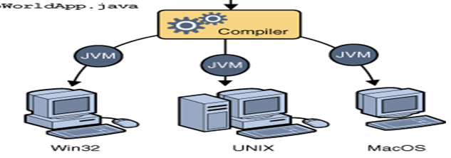
In JAVA there is two step …..
The source code is compile and a .Class file is created that contains the date in byte code format.
This byte code is again pass to the JVM(java virtual machine) and we get the executable file.
Java virtual machine is available on all operating system hence same class file is executed on different different platform

Slide 21
Security..
In JVM a module “Byte code verifier” verifies the byte code is valid or not.
If the byte code is coming from unsafe sources ,it will not be allow to communicate with the secured part.
Only legal code will get permission to access the secured information.

